Slide 1
Molecular Dynamics Analysis: Melting and MD Limitations
Dane Morgan
Last Update: 9/29/21

Slide 2
Outline
How can I analyze melting in Molecular Dynamics?
Energy vs T
<r^2> vs. T
Method to avoid hysteresis

Slide 3
Example: Melting Temperature (T_{m}) From MD
How can I get T_{m} from an MD simulation?
What physics determines melting?
Which ensemble should I use?
What will I actually calculate that will tell me if the systems has melted?
Simple picture:
Melting is a solid→liquid transition which occurs when we heat the system up enough that the materials stops being an ordered crystal and the atoms start moving around freely.

Slide 4
Example: Melting Temperature (T_{m}) From MD
Heating up a solid in a furnace in a lab is the NPT ensemble.
Melting is characterized by
More motion of atoms: So <r²> for atoms should increase a lot at melting
Less regular structure: So spatial correlation function should get much more diffuse, maybe with changes in coordination numbers
New phase with somewhat different density: So we should get a jump in the volume
Latent heat in the transition: So we should see a jump in the total energy
Different specific heat in solid and liquid: So we should see a discontinuity in the specific heat

Slide 5
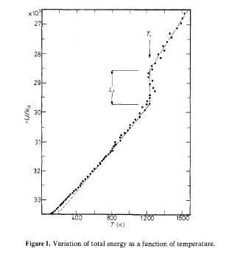
<Total Energy>=<U> vs. T for LiCl from MD
Amini, et al, J. Phys. C ‘90
T_{m}
C_{P}(liquid) = (dU/dt)_{N,P}
≠ C_{P}(solid)
Latent heat of transition
C_{P}(solid) = (dU/dt)_{N,P}

Slide 6
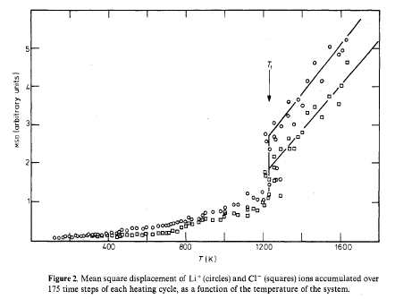
<r2> vs. T for LiCl from MD
Amini, et al, J. Phys. C ‘90
T_{m}
Small displacement in solid – primarily vibrations around lattice sites
Large displacement in liquid – atoms diffuse throughout system

Slide 7
Another Approach to Melting Temperature with MD Interface Method
Just heating within NPT ensemble tends to overestimate T_{m} by 20-30%!! Why? Melting is a first order transition, so the new phase (the liquid) has to nucleate, which tends not to happen on MD time scales until well above Tm.
Another approach: Melting is where the liquid and solid are in equilibrium, so they should be able to coexist. Start with ½ solid and ½ liquid at instantaneous T_{initial}≈Tm and let the system equilibrate. Use NPE ensemble. Then temperature will equilibrate to Tm.

Slide 8
Interface Method to Find T_{m}
Solid
Liquid
T_{initial}<T_{m} – Solid grows, latent heat given off by liquid and kinetic energy increases T until T≈_{Tm}
T_{initial}>T_{m} – Solid shrink, latent heat taken in by liquid and kinetic energy decreases T until T≈T_{m}
Solid
Liquid
Solid
Liquid

Slide 9
Summary
Molecular dynamics can directly simulate a melting process: Melting temperature can be found by jump in energy, trajectories, etc.
Hysteresis effects can be avoided by interface method (also other methods, e.g., thermodynamic integration).

